Slide 1
Chapter 4 Data structures for image analysis
Image processing, analysis and machine vision
Dong Sun Park
Wednesday, April 15, 2020

Slide 2
Contents
4.1 Levels of image data representation
4.2 Traditional image data structures
4.3 Hierarchical data structures
Data and algorithm are the two basic related parts of any program.

Slide 3
4.1 Levels of image data representations
Computer vision aims to find a relation between an input image and models of the real world.
Computer vision comprises a design of:
Intermediate representations (data structures)
Algorithms used for the creation of representations and introduction of relations between them
Several levels of visual information representation are defined on the way between the input image and the model:
Iconic images: contains original data, integer matrices with data about pixel brightness.
Segmented images: parts of the image are put into groups may belong to same objects.
Geometric representation: holds knowledge about 2D and 3D shapes. It is useful while doing general simulations of the influence of illumination and motion in real objects.
Relational models: makes us treat data efficiently and at a higher level of abstraction.

Slide 4
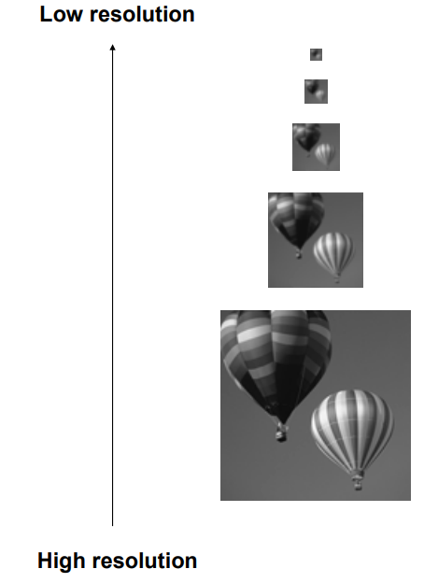

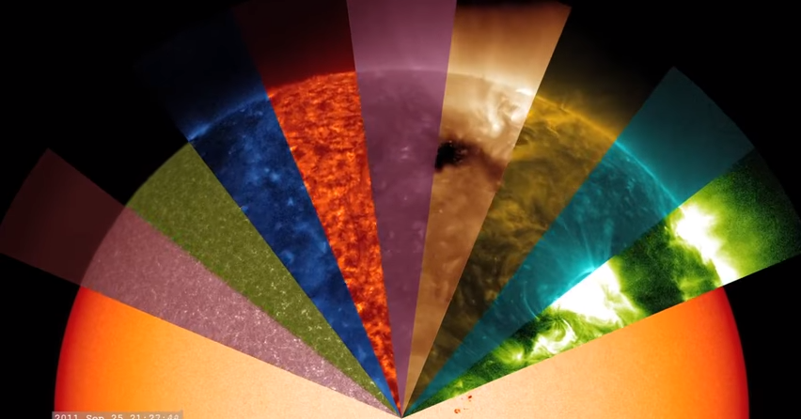
4.2 Traditional image data structures
Matrices. Very common.
Element is integer number corresponding to brightness or another property.
Coordinates: row and column indices.
With spatial relations, like neighborhood relation.
Special images:
Binary image: with only two brightness levels, 0 or 1.
Multispectral image: each matrix contains one image corresponding to one spectral band.
Hierarchical image data structures, such as multiple resolutions
Different spectral bands for sun

Slide 5
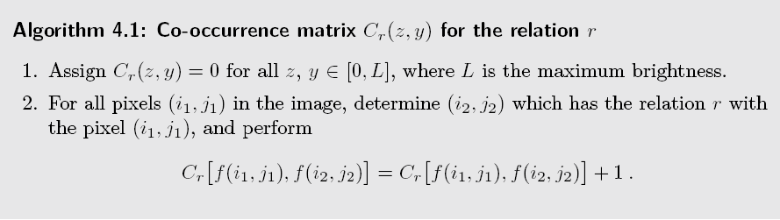

How to represent a matrix: a standard array data structure.
How to get global information from a matrix:
Histogram: looks at the image from a probabilistic point of view.
Co-occurrence matrix: estimate the probability of two pixels appearing in a spatial relationship in which a pixel has intensity $z$ and another pixel has intensity $y$. They can describe texture.

Slide 6
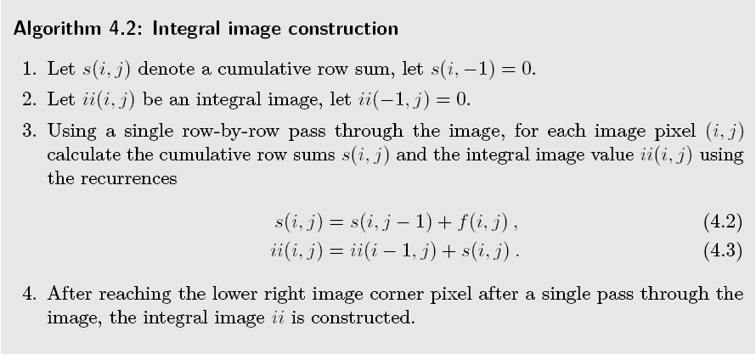
Integral image construction: can compute rapidly simple rectangle image features at multiple scales. These features are used for rapid object identification and for object tracking.

Slide 7
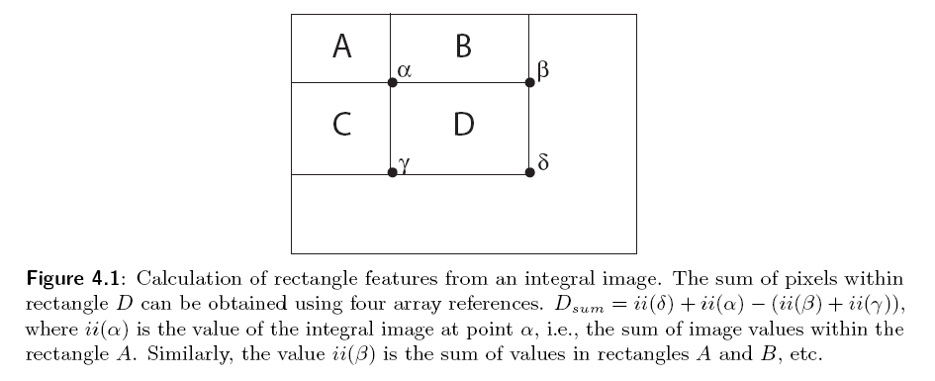
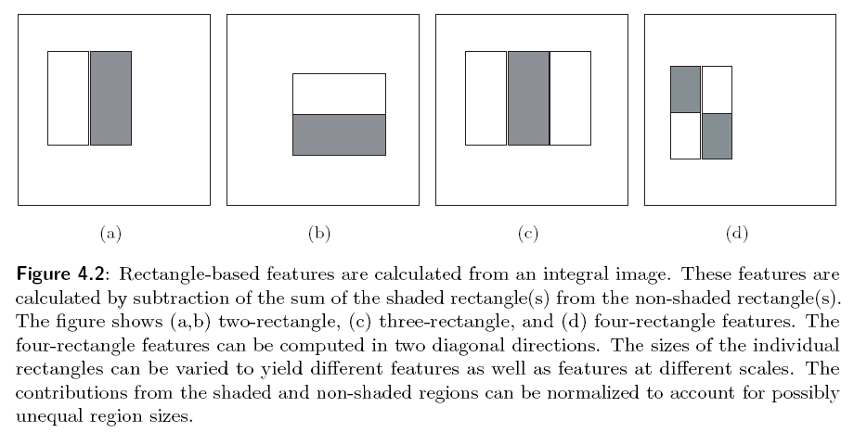

Slide 8
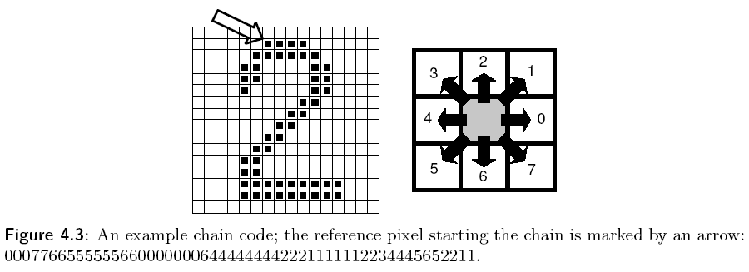
4.2.2 Chain
Chain. A basic symbol. Good for syntactic pattern recognition.
Can be used do describe object borders.
Linear structures, cannot describe spatial relation in the image, like neighborhood.
Chain code are often used for the description of object borders. The border is defined by the co-ordinates of its reference pixel and the sequence of symbols corresponding to the line of the unit in several pre-defined orientations.
If we want to get local information from chain code, it is necessary to search the whole chain systematically.

Slide 9
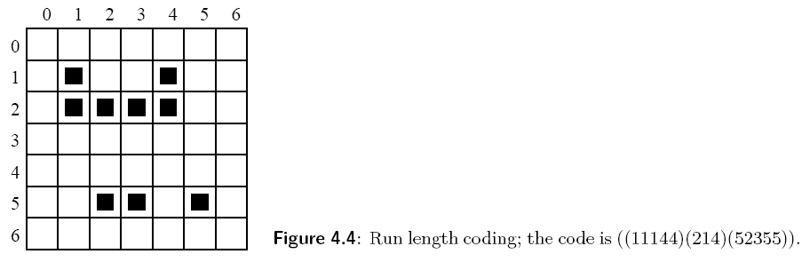
Run length coding, is often used to represent strings of symbols in an image matrix. Record only areas that belong to the object in the image, the are is then represented as a list of lists. Can also be used for an image with multiple brightness levels as well.

Slide 10
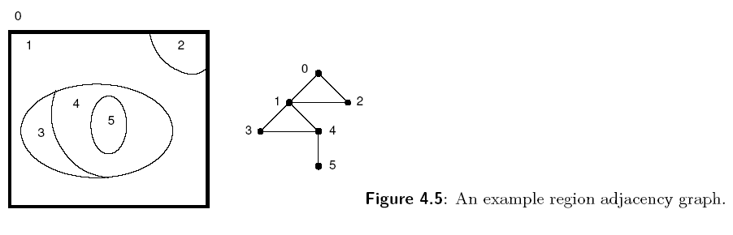
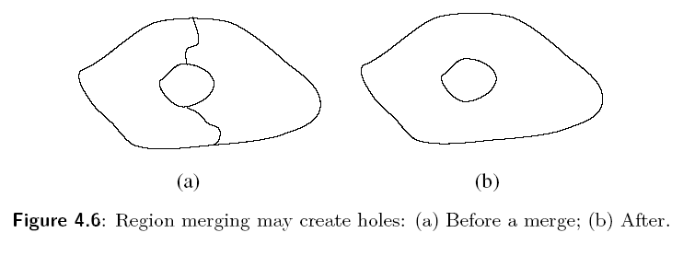
4.2.3 Topological data structures
Topological data describe the image as a set of elements and their relations which are often represented using graphs.
Region adjacency graph is typical, in which nodes correspond to regions and neighboring regions are connected by an arc.

Slide 11
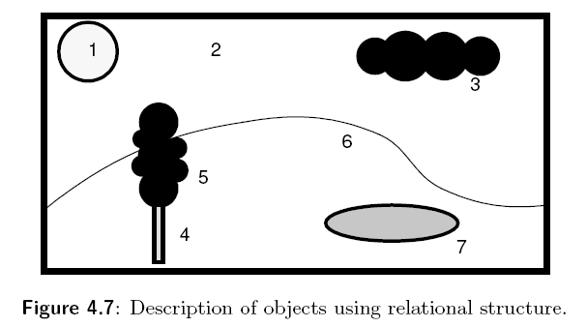
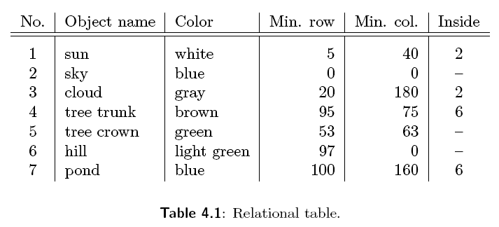
4.2.4 Relational structures
Relational structures, all the information is concentrated in relations between semantically important parts of the images—objects—that are the result of segmentation. Relations are recorded in the form of tables.

Slide 12
4.3 Hierarchical data structures
4.3.1 Pyramids
Pyramids, M-pyramids and T-pyramids.
M-pyramid (matrix-pyramid) is a sequence of images. Are used when it is necessary to work with an image at different resolutions simultaneous.

Slide 13
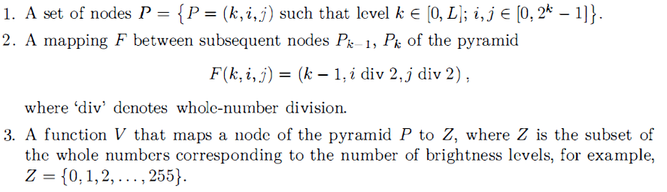
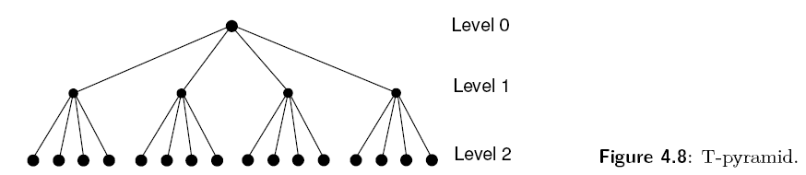

T-pyramid (Tree-pyramid). It is advantageous to use several resolutions simultaneously rather than chose just one image from the M-pyramid.
We define T-pyramid: ($2^{L}$ be the size of an original image)

Slide 14
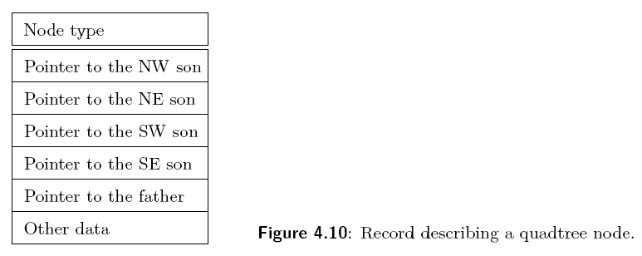
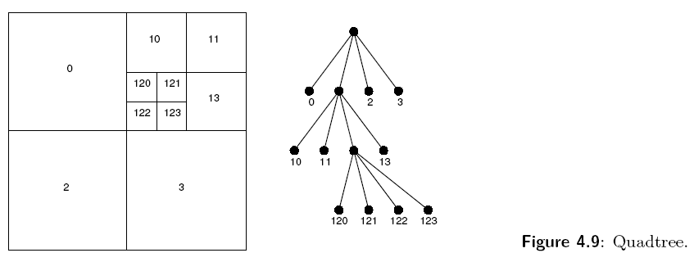
4.3.2 Quadtrees
Every node of the tree except the leaves has four children, north-western, north-eastern, south-western, south-eastern.
It is not mandatory to keep nodes at all levels.
We can also use quadtrees in individual objects instead of whole image.

Slide 15
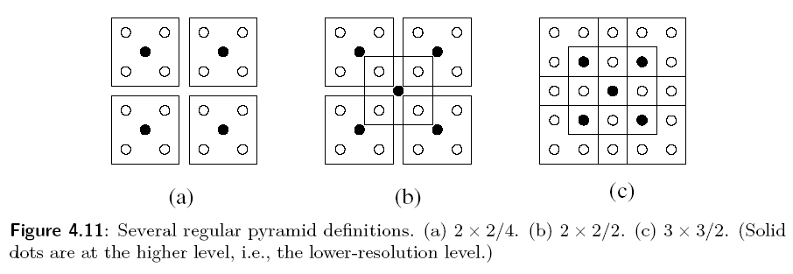

4.3.3 other pyramid structures
A taxonomy of regular pyramids may be constructed by considering the reduction window together with the reduction factor $λ$, which defines the rate at which the image area decreases between levels.

